Slide 1


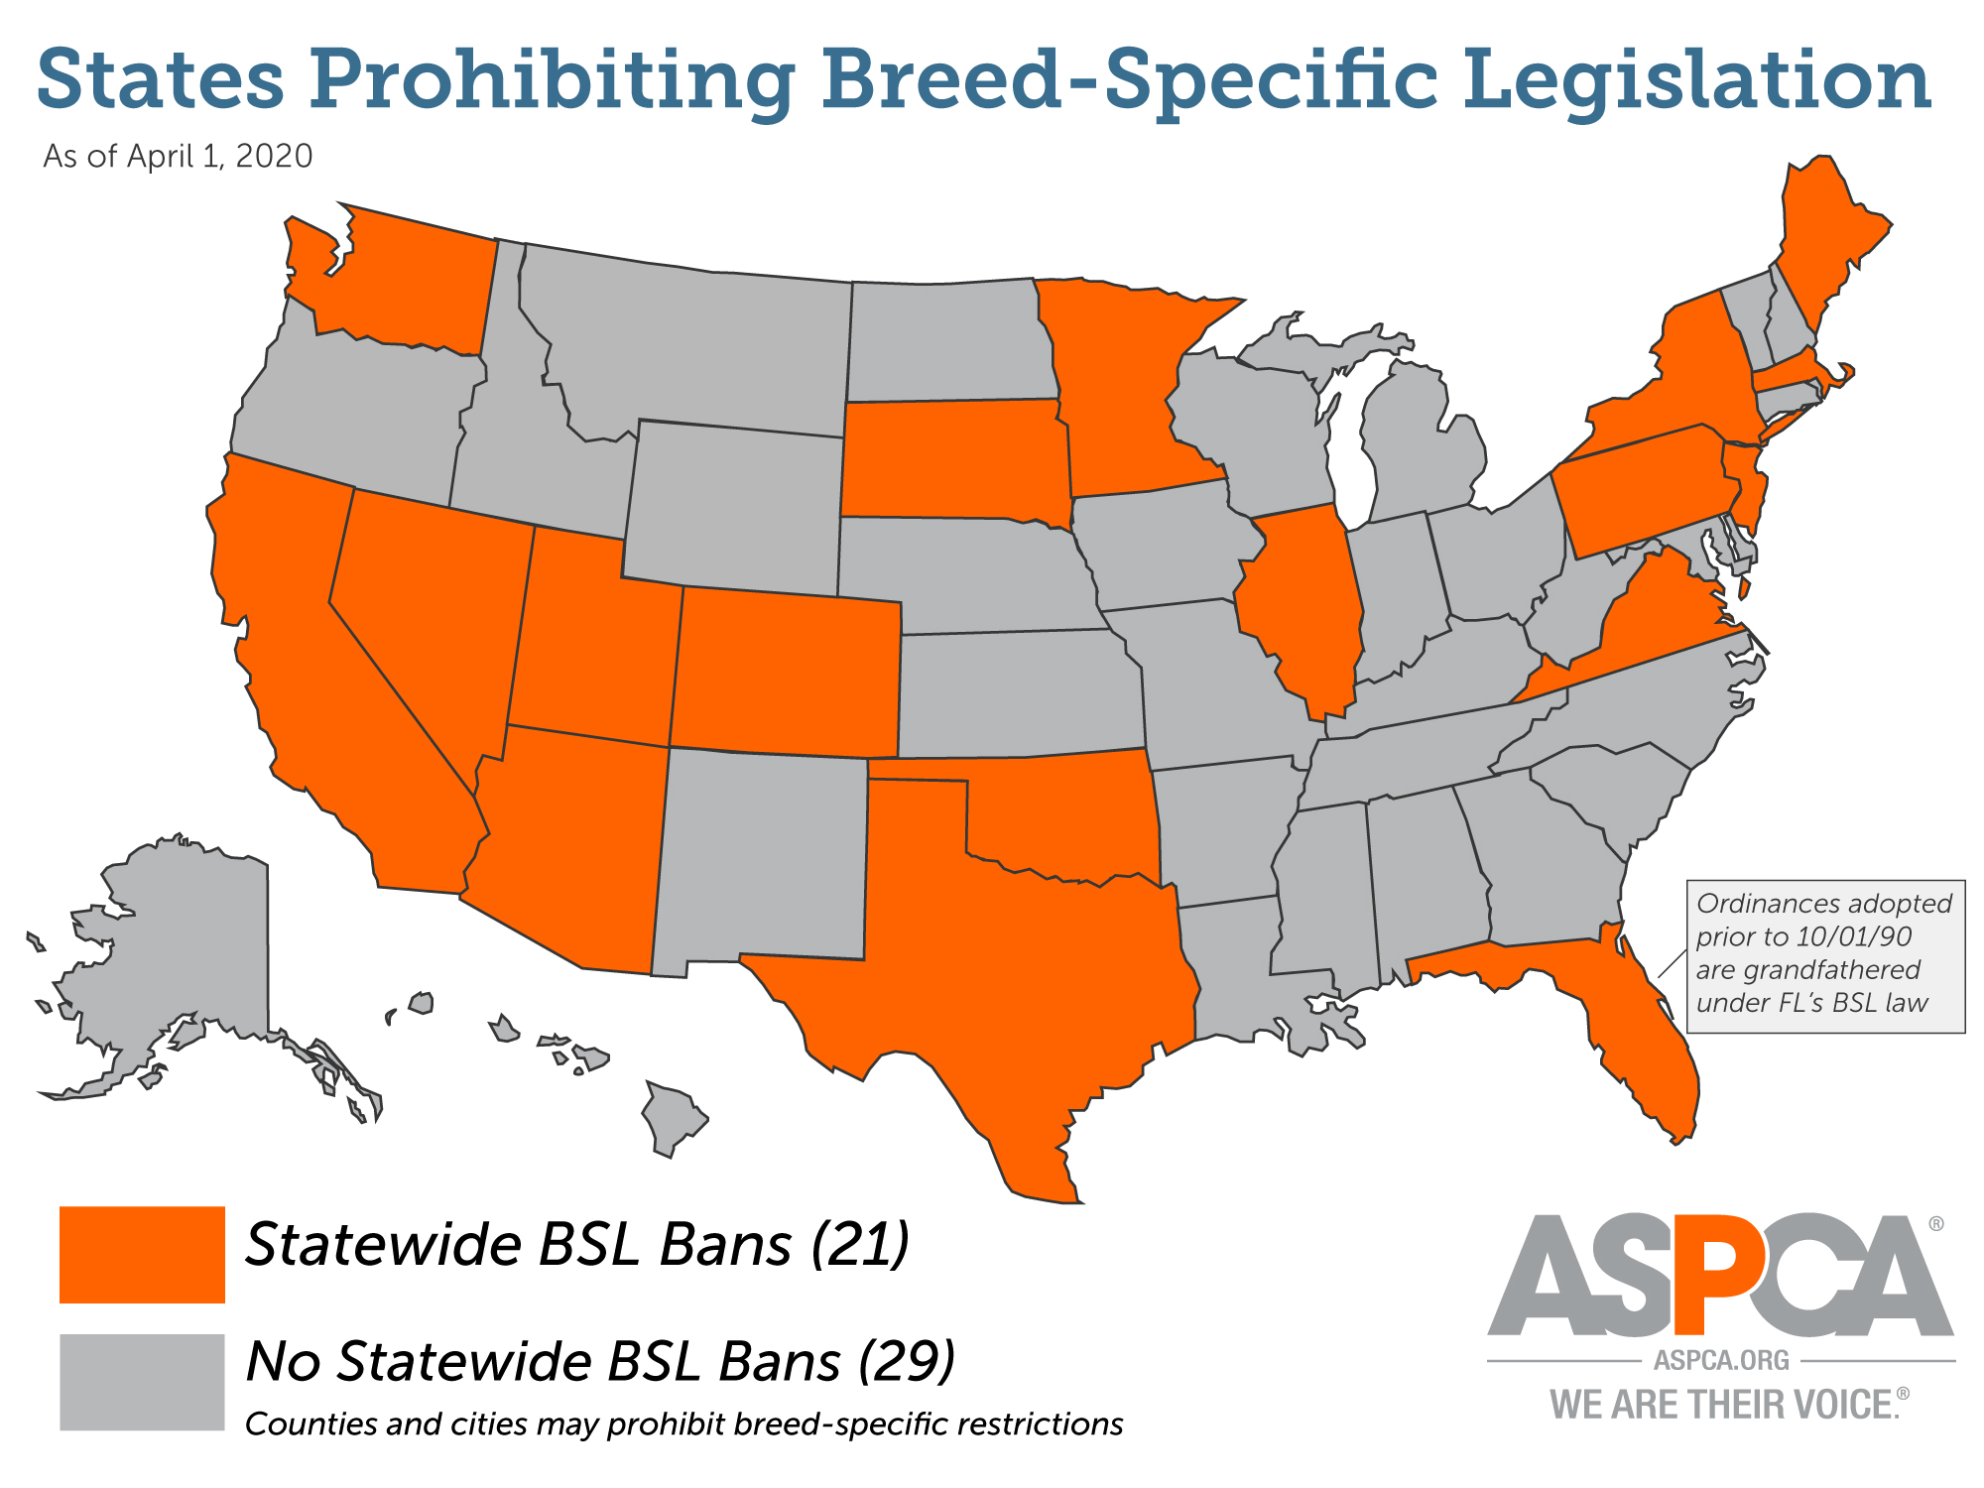
Awareness and Perception of breed specific legislation in a college of veterinary medicine
Tom Bunch and Vinicia Biancardi
Department of Anatomy, Physiology, and Pharmacology. College of Veterinary Medicine, Auburn University
INTRODUCTION
RESULTS
SUMMARY and DISCUSSION
Breed Specific Legislation (BSL) is the term for laws that regulates or ban certain dog breeds
The American Veterinary Medical Association, the Centers for Disease Control and Prevention (CDC) and several other animal protection institutions strongly oppose to BSL due to no evidence that BSL make communities safer for people or companion animals
However, more than 700 US cities in more than 50% states still endorse breed specific laws
Raising awareness in the general public may be a potential step towards population support in banning BSL
1) Demographics
279 responses were obtained. Most of the respondents identified as female, not Latino or Hispanic, and White
One-third of respondents indicated that they were not familiar with BSL.
Of people who indicated that they were familiar with BSL, 4.21% of respondents indicated that they either slightly support or strongly support BSL.
However, of people who indicated that they were not familiar, 11.76% indicated that they would either slightly support or strongly support BSL
Our study was not able to correlate breed ownership with race due to lack of diversity among the respondents.
However, a different and potentially more important question was answered. If in a college of veterinary medicine, where almost the entire population works with animals in some form, 31% of respondents are unaware of BSL, it would stand to reason that the general public is even less informed.
Therefore, we set a pilot survey to learn the level of awareness and perception of the population within the College of Veterinary Medicine at Auburn University (students, faculty and staff) in regards to BSL
There were 279 total responses to the survey. Most of the respondents identified as female, not Latino or Hispanic and White; aged between 18-30 years old and with a bachelor’s degree.
https://www.aspca.org/animal-protection/public-policy/what-breed-specific-legislation
CONCLUSION
AIMS
Our data supports that those who are unaware of BSL are more likely to be in support of it as compared to those who are aware, rising the importance of public awareness and education in the issue
Determine whether students and faculty at Auburn University College of Veterinary Medicine were aware of BSL
Gather the overall opinion of said legislation with the college
Determine whether certain perceptions were influenced by dog ownership and specific breed ownership.
2) Awareness and Perception of Breed specific legislation
FUTURE STUDIES
Our data were likely skewed by the fact that this study was sent out to a college of veterinary medicine. The level of knowledge of animal welfare or animal rights is very likely not indicative of the general public.
Therefore, our long term goal is to acquire large population data to understand whether there is a correlation between demographics, awareness and perception of BSL.
METHODS
Structured survey distributed for quantitative research
Survey questions included:
  Demographics
  Awareness of Breed-Specific Regulation
  Perception of Breed-Specific Regulation
The data collected were aggregated for comparison and correlations and expressed in Percent of total answers
Data was collected anonymously and voluntarily.
IRB protocol #20-500 EX2010
NO
31%
YES
69%
ACKNOWLEDGEMENTS
This work was co-sponsored by the Boehringer Ingelheim Vetmedica, Inc. Veterinary Scholars Program, and the Auburn University College of Veterinary Medicine.
Awareness of BSL are more likely to be in support of BSL bans

