Slide 1

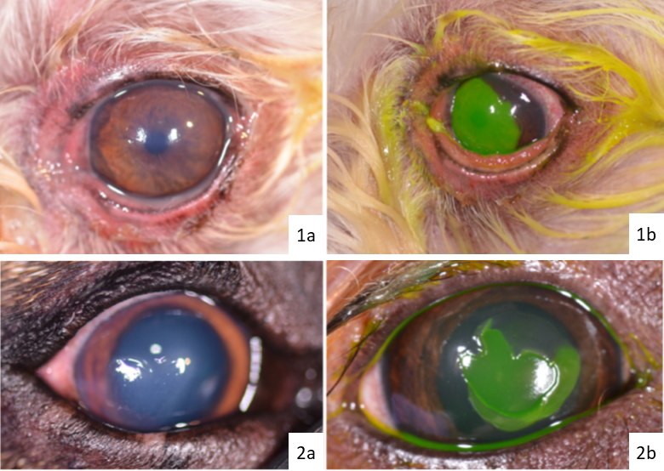
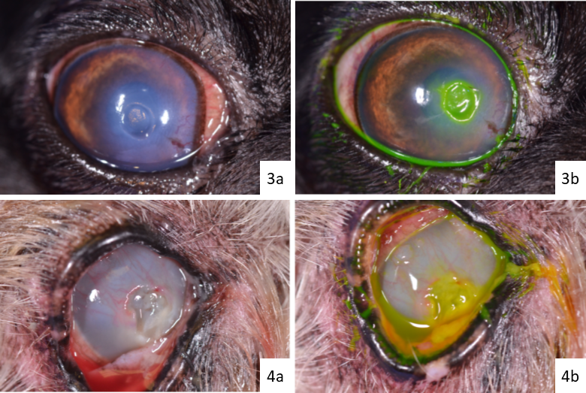
Investigation of Classification Accuracy and Clinical Management Trends of Corneal Ulcer Types Between General Practitioners and Ophthalmologists
SL Hoke¹, SD Boveland¹, PA Moore¹
¹Department of Small Animal Clinical Sciences, Ophthalmology, Auburn University College of Veterinary Medicine, Auburn, AL
INTRODUCTION
Picture 1a: Superficial Corneal Ulcer, pre-fluorescein stain
Picture 1b: Superficial Corneal Ulcer, post-fluorescein stain
Picture 2a: Indolent Corneal Ulcer, pre-fluorescein stain
Picture 2b: Indolent Corneal Ulcer, post-fluorescein stain
RESULTS
Corneal ulcerations are classified by the amount of stromal loss as well as unique differences in their appearance and behavior. Diagnosis of these ulcers requires use of fluorescein stain and a good ophthalmic exam. Inaccurate diagnosis can result in the mismanagement of a corneal ulcers, resulting in progression, infection, and possible perforation of the globe if stroma is lost, which can result in vision loss or loss of the eye.
25 veterinary general practitioners (GPs) and 122 veterinary ophthalmologists (Ophthalmologists), 147 total, participated in the electronic questionnaire. Overall accuracy in corneal ulcer classification was lowest for anterior stromal ulcers (33%) followed by indolent (86%), superficial (89%), and deep stromal (86%). There was a significantly higher correct percentage for ophthalmologists for both indolent (91.8% Ophthalmologists versus 56% GPs) and superficial (93.44% Ophthalmologists versus 68% GPs). Accuracy for indolent and superficial corneal ulcer classification was significantly higher with increased ophthalmology-based CE hours (20-30 hours/year for Ophthalmologists, 8-12 hours/year for GPs). There was a significant difference between Ophthalmologists and GPs that elected to perform a slit lamp exam under all 4 corneal ulcer types (On average, 31.25% of GPs vs. 92% Ophthalmologists) as well as indicated they’d use Carprofen 2.2 mg/kg as an anti-inflammatory (On average, 23% GPs vs. 70.25% Ophthalmologists). Regarding the individual ulcer types, there were significant differences (p<0.01) between the antibiotics, anti-collagenases, and physical therapeutic procedures chosen.
INSERT Photo or chart here.
Picture 3a: Anterior Stromal Corneal Ulcer, pre-fluorescein stain
Picture 3b: Anterior Stromal Corneal Ulcer, post-fluorescein stain
Picture 4a: Deep Stromal Corneal Ulcer, pre-fluorescein stain
Picture 4b: Deep Stromal Corneal Ulcer, post-fluorescein stain
PURPOSE
Evaluate and compare corneal ulcer type classification accuracy and current management trends between veterinary general practitioners (GPs) and veterinary ophthalmologists.
CONCLUSION
Accuracy between identification of most corneal ulcers was significantly higher for Ophthalmologists compared to General Practitioners. More ophthalmology-based CE hours increased diagnosis accuracy for both Ophthalmologists and General Practitioners. Anterior stromal ulcers had the lowest classification accuracy between both groups of subjects. Many General Practitioners do not utilize slit lamp biomicroscopy in their diagnostic plan when presented with corneal ulcers, which could play a role in decreased classification accuracy by General Practitioners. Treatments based on ulcer classifications varied within and between subgroups. Ophthalmology-based CE hours covering up-to-date diagnostics and therapeutic options are vital and encouraged in efforts to promote more accurate corneal ulcer classification and prevent unfavorable corneal ulcer management.
METHODS
A computer-based survey was formulated utilizing 4 images for classification evaluation, as well as an identical set of questions for each image regarding diagnostics, medications, physical therapeutics, and re-check intervals for the ulcer type the respondents classified. An alternative significance threshold of 0.01 was used. Fisher’s exact tests were used to compare classification accuracy of General practitioners and Ophthalmologists. Mann-Whitney tests were used to examine comparisons between Continuing Education (CE) hours, date of most recent CE, and re-check times between classified ulcer groups. Student t-tests with Satterthwaite correction were used to test if accuracy of classification correlated with age.
REFERENCES
ACKNOWLEDGEMENTS
Martin, Charles L, et al. Ophthalmic Disease in Veterinary Medicine. 2nd ed., CRC Press, 2018.
Moore PA. Diagnosis and management of chronic corneal epithelial defects (indolent corneal ulcerations). Clin Tech Small Anim Pract. 2003;18(3):168-177. doi:10.1016/s1096-2867(03)90013-2
Wilkie DA, Whittaker C. Surgery of the cornea. Vet Clin North Am Small Anim Pract. 1997;27(5):1067-1107. doi:10.1016/s0195-5616(97)50104-5
Thank you to the faculty and staff at Auburn University College of Veterinary Medicine Ophthalmology Service, Dr. Deborah Keys, and all the participants of this study.

