Slide 1
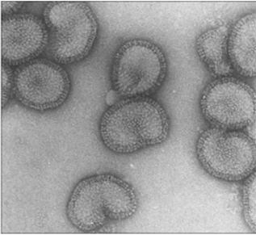
Oral presentation
Influenza neuraminidase virus-like particle vaccine platform as a candidate universal influenza vaccine in the porcine model.
Vasilis Pliasas¹, Zach Menne², Virginia Aida¹, Ji-Hang Yin¹, Peter J. Neasham¹, J. Fletcher North¹, Maria C. Naskou¹, Sheniqua Glover¹, Ioanna Skountzou², Constantinos S. Kyriakis^{1,3}
¹Department of Pathobiology, College of Veterinary Medicine, Auburn University, Auburn AL, USA
²Department of Microbiology and Immunology, Emory University, Atlanta GA, USA ³Center for Vaccines and Immunology, University of Georgia, Athens GA, USA

