Slide 1
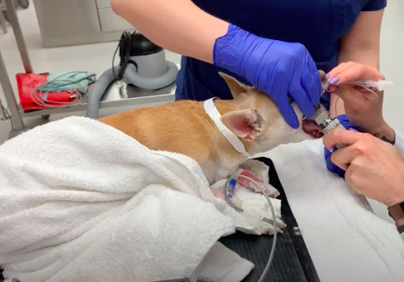
Oral presentation
Systematic Review of Literature Containing Quality of Anesthetic Induction and Recovery Scales used in Dogs to Assess for Validity and Applicability
Kathryn L. Wolfe¹ and Erik Hofmeister²
¹Department of Animals Sciences, Auburn University, AL
²Department of Clinical Science, College of Veterinary Medicine, Auburn University, AL

