Slide 1
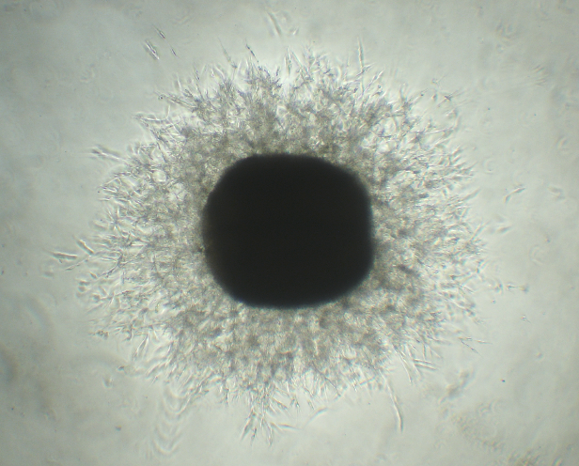
Oral presentation
Equine arterial ring assay as an ex vivo model for vasculogenesis in horses
Mariano Mora-Pereira¹, Katelyn Kahler¹ and Anne A. Wooldridge¹
¹Department of Clinical Sciences, Auburn University, AL

