Slide 1
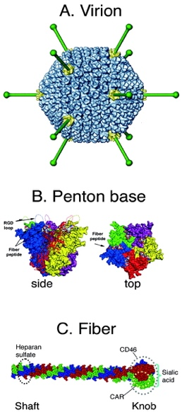
Poster presentation
Elucidation of Canine Adenovirus type 2 tropism
Madison D Hogans¹, Will Kretzschmar¹, Payal Agarwal^{1, 2}, Bruce F Smith^{1, 2}
¹ Scott Ritchey Research Center, College of Veterinary Medicine, Auburn University, AL
²Department of Pathobiology, College of Veterinary Medicine, Auburn University, AL

Slide 2
The Importance of Gene Therapy
Gene therapy is the transfer of genetic material into target cells for the purpose of gene expression or editing
Gene therapy is used to treat many diseases such as cancer, cystic fibrosis, diabetes, and hemophilia
The natural tropism of a virus can be modified to transduce specific cells or deliver genes to targeted cells
Adenoviral vectors, especially human adenovirus Ad5, are excellent contenders for Gene Therapy

Slide 3
Human Adenovirus (AD5)
Ad5 based vectors are most commonly used due to high transduction-efficiency, larger payload, easy genetic manipulation, nearly ubiquitous tropism, and non-integration into the host genome
Ad5 attach to cells by the cell surface coxsackie and adenovirus receptor (CAR) and internalizes using cell surface integrin ((avb5, avb3) or major histocompatibility complex class I (MHC-I)
AD5 tropism, delivery mechanism, and expression parameters can easily be modified
However, Ad5 based vectors fail to infect a variety of cells due to low CAR or cell surface integrin expression, including some neuronal cell subtypes, cells of lymphocyte origin, and some highly malignant cells (e.g. ovarian, colorectal, lung, prostate, breast, and bladder cancer)

Slide 4
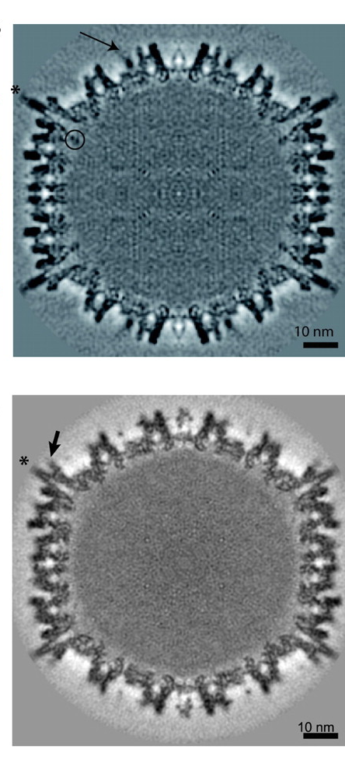
Canine Adenovirus type 2 (CAV2)
CAV2 is a promising vector with characteristics similar to human Ad5
CAV2 vectors have the capability to transduce several cell types that are not infected by Ad5
Ad5’s loops are involved in immune recognition in addition to the internalization function of the RGD loop in penton base. CAV2 lacks an RGD loop and is therefore not dependent on integrins
Interestingly, the CAV2 C-terminus of protein IX is in a different position compared to Ad5, and makes an antenna-like projection sticking out of the capsid (22). The function of this antenna and its role in CAV2 internalization is not known.
CAV2 transduction may be augmented by CAR. However, it is, at least in some cells, CAR and integrin independent.
We propose to identify the cell surface molecules involved in CAV2 internalization

Slide 5
Methods
Human and canine cell lines were infected with Ad5G/L and CAVGFP for 48 hours and analyzed for green fluorescence using flow cytometry
CAVGFP and Ad5G/L are replication incompetent recombinant adenoviral vectors with Green fluorescence protein (GFP) inserted in the genome under the expression of CMV promoter
All cell lines were cultured according to standard procedures
Canine cell lines
Lymphoma | 1771, OSW
Mast cell tumor | MPT1
Mammary tumor | CMT28
Histiocytic tumor | DH82
Melanoma | CML7, CML10
Human cell lines
Ovarian | SKOV3

Slide 6
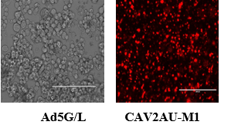
Result and Conclusions
CAVGFP infects cells that are refractory to Ad5G/L such as, canine lymphoma cell lines 17-71 and OSW and canine mast tumor cell line MPT1
CAVGFP can transduce cells at lower MOIs (10 and 100) in comparison to Ad5G/L in both canine and human cell lines
 | CAVGFP |  |  |  | Ad5GFP
Cell Line | 0 MOI | 10 MOI | 100 MOI | 1000 MOI | 0 MOI | 10 MOI | 100 MOI | 1000 MOI
OSW | 0.40 | 2.45 | 16.89 | 48.01 | 0.20 | 0.30 | 0.50 | 4.90
17-71 | 0.71 | 16.81 | 63.24 | 75.15 | 0.40 | 0.40 | 0.40 | 0.60
MPT1 | 0.80 | 7.39 | 68.08 | 89.15 | 0.70 | 0.50 | 1.60 | 1.80
DH82 | 0.43 | 6.17 | 42.22 | 89.72 | 0.30 | 0.50 | 6.20 | 55.00
CMT28 | 0.36 | 4.94 | 31.35 | 83.21 | 0.80 | 0.90 | 10.10 | 62.90
CML7 | 0.36 | 2.14 | 12.41 | 59.27 | 0.40 | 1.10 | 11.10 | 74.80
CML10 | 0.32 | 13.85 | 63.18 | 98.65 | 0.20 | 0.80 | 8.70 | 70.60
SKOV3 | 0.20 | 4.91 | 22.64 | 35.25 | 0.40 | 0.68 | 5.31 | 37.37
PC-3 | 0.68 | 3.99 | 22.58 | 51.21 | 0.77 | 16.05 | 70.03 | 92.22

Slide 7
Future Goals
We will use an affinity isolation approach using whole virus (CAVGFP) to identify the cell surface molecules associated with cell binding and internalization of CAV2.

