Slide 1
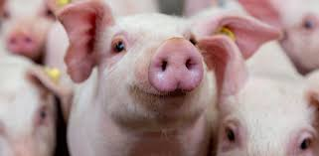
Poster presentation
Effects of lactocrine insufficiency from birth on the uterine transcriptome
and gut microbiome in neonatal pigs on postnatal day 14
Xiaolei Ma¹, Wenqi Cao¹, Clay A. Lents³, Carol A. Bagnell^{4†}, Frank F. Bartol^{1,2†} and Xu Wang^{1,2,5†}
¹College of Veterinary medicine
² Alabama Agricultural Experiment Station
³USDA-ARS, US Meat Animal Research Center
⁴ Department of Animal Sciences, Rutgers University
⁵HudsonHudsonAlpha Ins􀆟tute for Biotechnology.

Slide 2
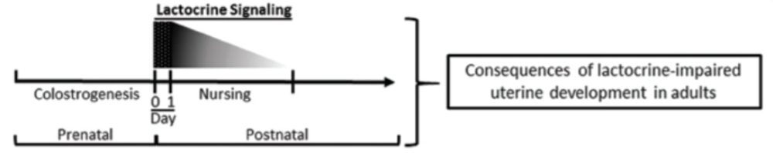
Introduction
Maternal effects on offspring phenotype do not end at birth.
Previous research established that lactocrine insufficiency from birth in pigs altered the postnatal uterine developmental program and reduced lifetime fecundity in adult, neonatally lactocrine insufficient females.
Picture from F. F. Bartol et, al. Journal of animal science, 95(5), 2200-2210 [1]

Slide 3
Research Aim
To determine the effects of lactocrine insufficiency from birth on the gut microbiome and uterine transcriptome in gilts on PND14 using whole genome shotgun metagenomic and transcriptomic sequencing approaches.

Slide 4
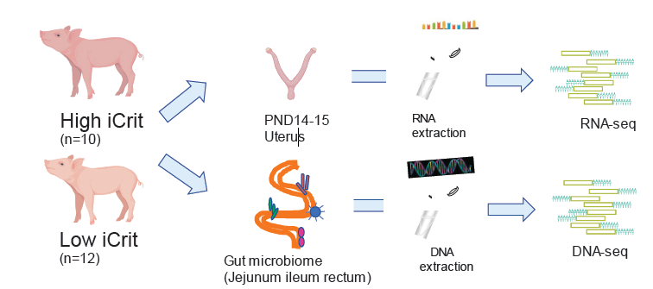
Design
Lactocrine insufficiency from birth in pigs is indicated by reduced serum immunoglobulin immunocrit (iCrit) ratios.

Slide 5
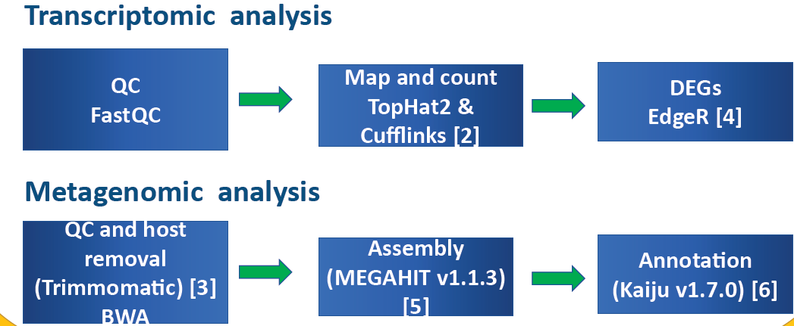

Slide 6
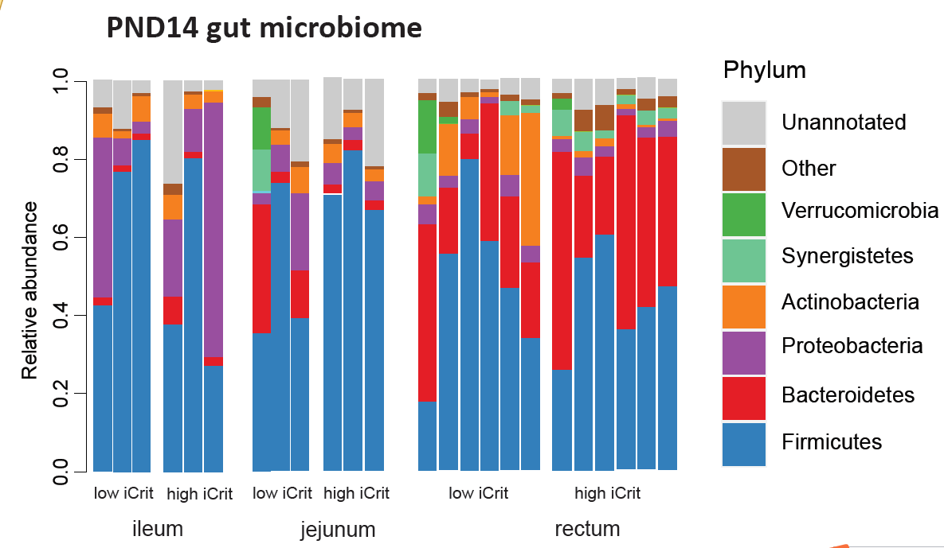

Slide 7
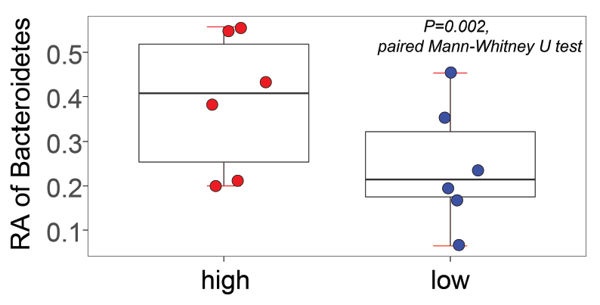

Slide 8
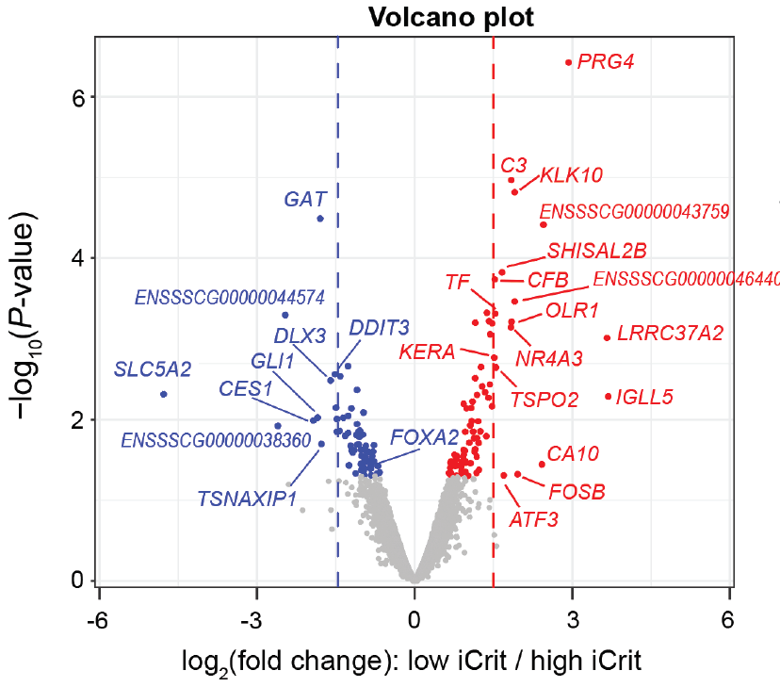

Slide 9
