Slide 1

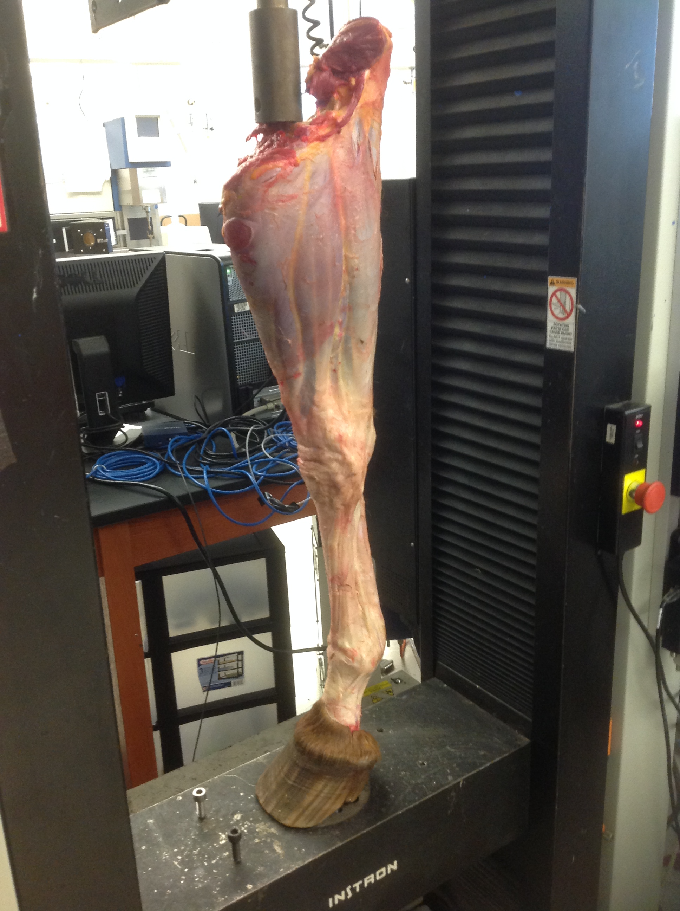
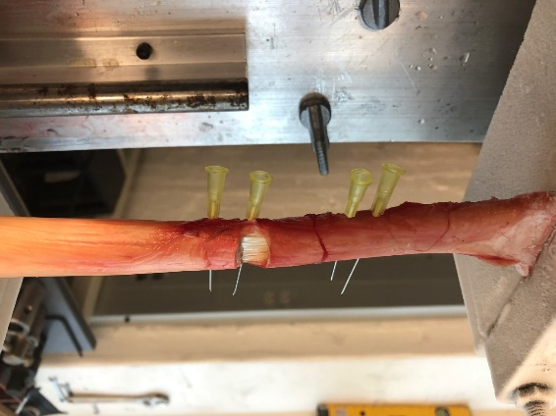
An ex-vivo Study of Double Hemitenotomy for Lengthening of the Equine Deep Digital Flexor Tendon
Zetterström S.¹, Boone L.¹, Weimar W.², Farag R.³, Caldwell F.¹
¹Department of Clinical Sciences, Auburn University, AL
²Department of Kinesiology, Auburn University, AL
³Department of Polymer and Fiber Engineering, Auburn University, AL
Introduction
Methods
Deep digital flexor (DDF) tenotomy is the current standard surgical technique to treat horses with refractory laminitis resulting in a guarded prognosis for athletic use.
Hemitenotomy is described in human medicine for lengthening of the Achilles tendon.¹
A surgical procedure for DDFT lengthening may be advantageous and allow for better recovery of tendon function.
Two off-set hemitenotomy incisions incorporating 50% of the tendon thickness created 3 cm apart at the mid cannon bone using a Licthy teat knife.
Part 1 (n=30 isolated DDFTs): Two hemitenotomy incisions were created in 15 tendons while the other 15 served as intact controls. Monotonic tensile load applied to a maximum of 500 kg using an Instron Universal Testing Machine (Figure 1). Tendon lengthening, load reduction with hemitenotomy and load at failure recorded.
Part 2 (n=16 complete forelimbs): all 16 subjected to DHT followed by complete tenotomy under monotonic compressive load applied by an Instron (Figure 2).
Independent and paired sample t-tests as well as repeated measures ANOVA. Significance level at p<0.05.
Objective
Objective: Develop a double hemitenotomy (DHT) technique to lengthen the equine DDFT.
Results
DHT resulted in significant DDFT lengthening and load reduction (part 1 and 2). Less lengthening with DHT compared to complete tenotomy (p<.001).
No difference in load reduction between DHT and complete tenotomy (p=0.65). The first hemitenotomy resulted in a smaller load reduction compared to the second hemitenotomy.
In part 1, 12/15 (80%) of the isolated hemitenotomized tendons failed at a mean ± SD tensile load of 173.8± 127.6 kg compared with none of the intact tendons (p=0.003). None of the tendons failed in part 2.
Figure 2: Complete forelimb mounted in an Instron Testing Machine. A compressive load (arrow) corresponding to in vivo conditions was applied. Hemitenotomies were created and measurements recorded. A complete tenotomy was then performed and length and load reduction recorded.
Acknowledgments
1
2
2
1
The authors would like to thank the Birmingham Racing Commission for funding this study. We would additionally like to thank Jessica Brown and the necropsy department at Auburn University for helping to collect the specimens.
Figure 1: Isolated DDFT mounted in the Instron Testing Machine between two cryo-clamps. The 2 outermost needles (1) are used for measuring lengtening following hemitenotomy incisions. The 2 innermost needles (2) are placed 3 cm apart at a 50% tendon thickness at the hemitenotomy sites. A tensile (arrow) load is applied until tendon failure or a maximum of 500 kg.
Conclusions
DHT load reduction is comparable to complete tenotomy.
DHT potential alternative surgical technique to complete tenotomy.
In-vivo studies needed.
References
Hoke M: An operation for the correction of extremely relaxed flat feet. Journal of Bone and Joint Surgery 13:773-783, 1931.

