Slide 1

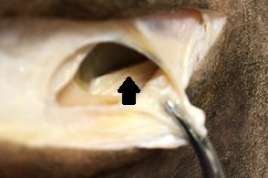
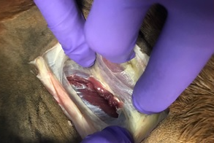
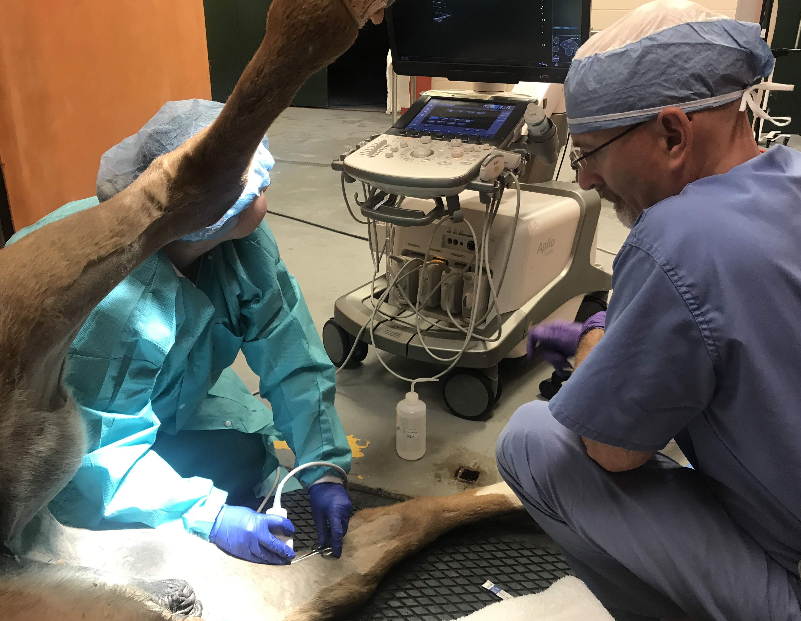
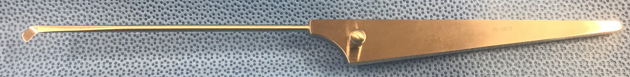
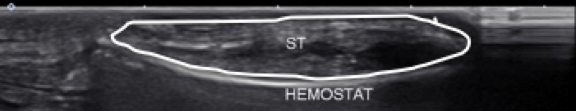
An ex-vivo Study of a Minimally Invasive Technique for Tenotomy of the Tibial Insertion of the Semitendinosus Muscle in Horses
Zetterström S.¹, Boone L.¹, Weatherall K.¹, Caldwell F.¹
¹Department of Clinical Sciences, Auburn University, AL
Introduction
Methods
Fibrotic myopathy is a mechanical hind limb gait abnormality that may interfere with performance.¹
The condition develops with fibrosis of the semitendinosus (ST) or less commonly semimembranosus, biceps femoris or gracilis muscles.¹
ST tenotomy is recommended in severe cases. A long (4-10 cm) incision has previously been described for exposure and isolation of the tibial insertion of the ST.²
Sixteen hind limbs from 8 equine cadavers included.
A 1.5 cm vertical stab incision was made distocaudal to the tibial insertion of the ST.
A pair of mosquito hemostatic forceps were introduced under the ST tendon (Figure 1).
Ultrasonography was performed confirming that the tendon was isolated (Figure 2) before a retrograde knife (Figure 3) was used to transect the tendon.
After transection, the tendon edges immediately retracted and ultrasonography was repeated to confirm complete transection.
Cadaver limbs were dissected to confirm complete transection of the tendon and to identify any iatrogenic trauma.
4A
4B
Figure 4: Gross dissection. A: Complete tenotomy with no iatrogenic damage to underlying musculature. The arrow is pointing at the caudal portion of the transected ST tendon. Note retraction of the cranial and caudal cut edge B: Superficial iatrogenic damage to the underlying gracilis muscle belly.
Objective
Conclusions
Objective: Describe a minimally invasive ultrasound assisted approach for ST tenotomy.
A minimally invasive ST tenotomy technique was successfully developed in cadaver specimens for treatment of fibrotic myopathy in horses.
Ultrasonography was helpful to assist the transection.
The technique was associated with occasional and only minor iatrogenic damage that was considered unlikely to be of clinical significance.
Study findings support use of a minimally invasive ST tenotomy as an alternative to traditional approaches.
Results
Tenotomy of the tibial insertion of the ST tendon was complete in all limbs (Figure 4A).
Complete transection of the tendon resulted in a palpable gap forming between the tendon edges and this was confirmed using ultrasonography.
Superficial iatrogenic laceration to the underlying gracilis muscle (n=2, Figure 4B) or gracilis fascia (n=1) was apparent in 3/16 limbs.
Acknowledgment
The authors wish to thank Jessica Brown for technical assistance.
References
Figure 2: Transverse ultrasonograpic image. The ST tendon is isolated above the hemostat. The tendon is just deep to the skin and it’s margins are delineated by the white circle.
Martens A. Biology and management of muscle disorders and diseases. In: Equine Surgery, 5th ed. Eds: Auer JA, Stick JA, Kummerle JM and Prange T. St Louis, MO: Elsevier; 2019:1445-1458.
Suarez‐Fuentes DG, Tatarniuk DM, Caston SS, Kersh KD, Gillen AM, Hays AM. Tenotomy of the semitendinosus muscle under standing sedation versus general anesthesia: Outcomes in 20 horses with fibrotic myopathy. Vet Surg. 2018;47(3):350-356.
Figure 1: Ultrasonograpic confirmation of ST tendon isolation above the hemostat.
Figure 3: Arthroscopic retrograde knife (45 degree).

