Slide 1

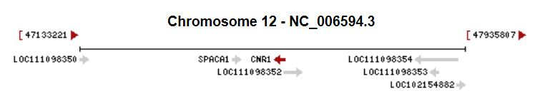
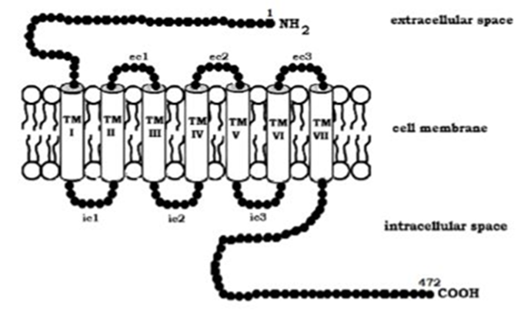


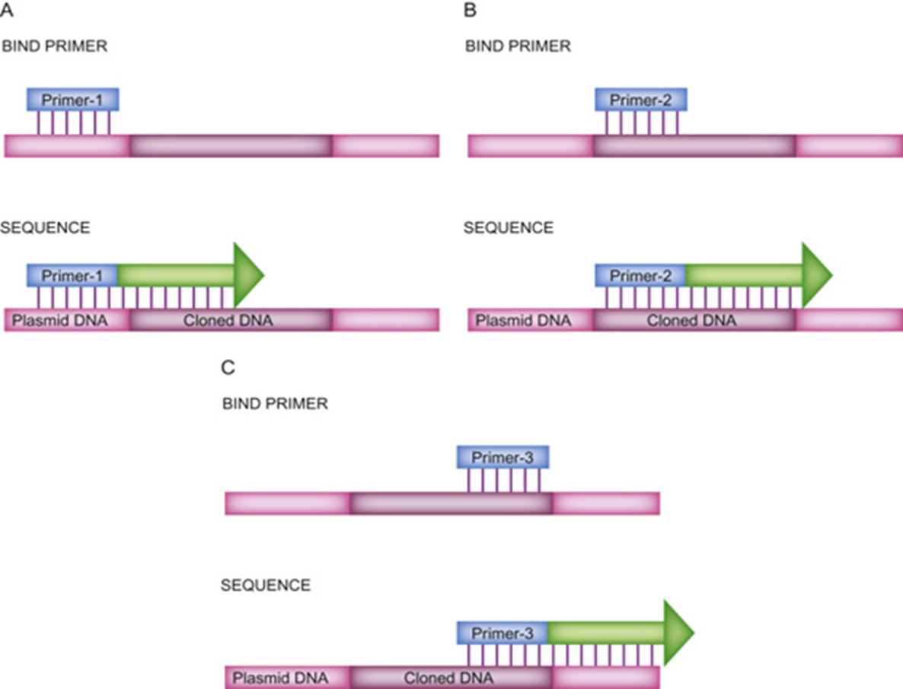
Characterization of the Cannabinoid Receptor – 1 Gene in Three Beagle Dogs and Six Cats
Sarah Ezell and Dr. Kamoltip Thungrat
INTRODUCTION
RESULTS
Cannabidiol oil and associated products are rapidly growing in popularity not only in human medicine, but also in veterinary medicine. Cannabidiol’s described therapeutic benefits are largely anecdotal, and efficacy in animals has yet to be confirmed. The main goal of our research project is to characterize the CB1, CB2, and TPRV1 receptors involved in the endocannabinoid system in canine and feline models, and to understand how genetic variation within these receptors can lead to variable pharmacologic outcomes. Cannabidiol has a long list of therapeutic indications, ranging from anxiety to epilepsy to pain management. However, therapeutic results have been largely variable, and full understanding of the efficacy of cannabidiol as a treatment option for these disease processes is not completely understood. It is hypothesized that genetic variation within these receptors plays a role in the variable outcomes when treating with CBD. The current focus of this research project is to identify genetic variation within the cannabinoid receptor 1 (CBR-1) gene in three healthy beagle dogs and six cats (three healthy and three Tay-Sachs disease) and to understand the role of this genetic variation in various disease processes and in variation of clinical outcomes. Current efforts are focused on the canine model.
At this point in the research project, work is still being done to assess genetic variation within these sequences. Current findings on the reverse complement sequence include a SNP located at base pair 20,534 in the canine model. NCBI genomic data defines this location as a cytosine, but in two of the three beagle dogs, this location is defined as a thymine. Base pair 20,534 is located within the region of the X3 exon. Analysis of the canine and feline CBR-1 sequences is still in progress.
https://www.ncbi.nlm.nih.gov/gene/481913
SNP located at base pair 20,534 within X3 exon
METHODS
Canine and Feline CBR-1 genetic data was obtained from the NCBI database, and primers were designed using the primer designing tool and BLAST on the NCBI database. The primer walking method was used to sequence CBR-1. The primer walking method is utilized when working with a long sequence. The sequence of interest can be cut into smaller, consecutive fragments averaging between 300-600bp in length, and primers can be designed that sequence the individual fragments. The result will be multiple, small sequences that combine to form the complete sequence of interest. A total of 240 primer pairs were designed for the canine model, gene reference NC_005594.3, and from those, 75 were selected for PCR. The forward primer and reverse primer PCR products were sequenced, and current alignment and analysis efforts are focused on the reverse complement sequence. The NCBI-BLAST program was used to check the site and accuracy of the selected primers. PCR was run, and gel electrophoresis was used to confirm the PCR products. Following gel confirmation, the PCR products were sent to PSOMAGEN Labs (Rockville, MD) for sequencing. The sequence results were aligned and identified for single nucleotide polymorphisms (SNPs) using Mega-X software (Kumar et. al, 2008).
CONCLUSION
Conclusive results cannot be drawn from the obtained data at this time, and more work needs to be done to determine whether this SNP will have an impact on the amino acid sequence and protein product. The next step is to determine the potential for splice site variation, and therefore variation in mRNA products. In conclusion, even if genetic variation is shown to have an impact on protein structure, work has to be done to determine whether the variation in clinical outcomes associated with CBD treatment can be attributed to this genetic variation. In the future, we hope to see that genetic variation within the endocannabinoid receptor system is utilized when forming a treatment plan for a patient.
REFERENCES
Picone, Robert & Khanolkar, Atmaram & Xu, Wei & Ayotte, Lionel & Thakur, Ganesh & Hurst, Dow & Abood, Mary & Reggio, Patricia & Fournier, Donna & Makriyannis, Alexandros. (2006). (-)-7′-Isothiocyanato-11-hydroxy-1′,1′-dimethylheptylhexahydrocannabinol (AM841), a High-Affinity Electrophilic Ligand, Interacts Covalently with a Cysteine in Helix Six and Activates the CB1 Cannabinoid Receptor. Molecular pharmacology. 68. 1623-35. 10.1124/mol.105.014407.
National Center for Biotechnology Information (NCBI)[Internet]. Bethesda (MD): National Library of Medicine (US), National Center for Biotechnology Information; [1988] – [cited 2020 Oct 29]. Available from: https://www.ncbi.nlm.nih.gov/
Sudhir Kumar, Glen Stecher, Michael Li, Christina Knyaz, and Koichiro Tamura (2018) MEGA X: Molecular Evolutionary Genetics Analysis across computing platforms. Molecular Biology and Evolution 35:1547-1549
Demonstration of the primer walking method
(Picone et. al, 2006)
https://www.sciencedirect.com/topics/neuroscience/primer-walking
ACKNOWLEDGEMENTS
All work for this project is being conducted in Dr. Dawn M. Boothe’s Clinical Pharmacology Laboratory.

